Slide 1
Software Process
劉建宏
台北科大資工系

Slide 2
Software engineering
Software engineering is an engineering discipline that is concerned with all aspects of software production from the early stages of system specification through to maintaining the system after it has gone into use.
Engineering discipline
Using appropriate theories, methods, and tools to solve problems bearing in mind organizational and financial constraints.
All aspects of software production
Not just technical process of development. Also project management and the development of tools, methods etc. to support software production.
* Software engineers adopt a systematic and organized approach to their work.
The systematic approach is sometimes called a software process.

Slide 3
Importance of software engineering
More and more, individuals and society rely on advanced software systems. We need to be able to produce reliable and trustworthy systems economically and quickly.
Software engineering methods and techniques are required for economically and quickly building a quality and long-life software that can be large or complex
It is usually cheaper, in the long run, to use software engineering methods and techniques for software systems rather than just write the programs as if it was a personal programming project.
For most types of system, the majority of costs are the costs of changing the software after it has gone into use.

Slide 4
Software process activities
A software process is a sequence of activities leading to the production of software. Four fundamental activities:
Software specification, where customers and engineers define the software that is to be produced and the constraints on its operation.
Software development, where the software is designed and programmed.
Software validation, where the software is checked to ensure that it is what the customer requires.
Software evolution, where the software is modified to reflect changing customer and market requirements.
Different types of systems need different development processes
Generic activities may organized in different ways and described at different levels of detail

Slide 5
Software process descriptions
When we describe and discuss processes, we usually talk about the activities in these processes such as specifying a data model, designing a user interface, etc. and the ordering of these activities.
Process descriptions may also include:
Products (or deliverables), which are the outcomes of a process activity;
Roles, which reflect the responsibilities of the people involved in the process;
Pre- and post-conditions, which are statements (conditions) that are true before and after a process activity has been enacted or a product produced.

Slide 6
Plan-driven and agile processes
Plan-driven processes are processes where all of the process activities are planned in advance and progress is measured against this plan.
In agile processes, planning is incremental and it is easier to change the process to reflect changing customer requirements.
In practice, most practical processes include elements of both plan-driven and agile approaches.
There are no right or wrong software processes.
The right process depends on the customer and regulatory requirements, the environment where the software will be used, and the type of software being developed
Software processes can be improved by process standardization (helping process communication, training, automation, and to include good SE practices)

Slide 7
Software process models
A software process model (sometimes called a Software Development Life Cycle or SDLC model or process paradigms) is a simplified representation of a software process.
A software process model is an abstract representation of a process
Each process model represents a process from a particular perspective and thus provides partial information about that process
For example, a process activity model show the activities and their sequence but may not show the roles of people involved in these activities

Slide 8
Software process models (from an architectural perspective - process framework )
The waterfall model (software life cycle)
Plan-driven model. Separate and distinct phases of specification and development.
Plan and schedule all of the process activities before starting software development
Incremental development
Specification, development and validation are interleaved. The system is developed as a series of versions (increments) by adding functions incrementally. May be plan-driven or agile.
Integration and configuration (Reuse-oriented software engineering)
The system is assembled from existing configurable components. May be plan-driven or agile.
In practice, most large systems are developed using a process that incorporates elements from all of these models.

Slide 9
The waterfall model

Slide 10
Waterfall model phases
There are separate identified phases in the waterfall model:
Requirements analysis and definition
System and software design
Implementation and unit testing
Integration and system testing
Operation and maintenance
The main drawback of the waterfall model is the difficulty of accommodating change after the process is underway. In principle, a phase has to be complete before moving onto the next phase. In practice, the waterfall process is never a simple linear model but involves feedback from one phase to another

Slide 11
Waterfall model problems
Inflexible partitioning of the project into distinct stages makes it difficult to respond to changing customer requirements.
Therefore, this model is only appropriate when the requirements are well-understood and changes will be fairly limited during the design process.
It is appropriate for embedded systems (the requirements are inflexible to change), critical systems (the need for extensive requirement analysis and design), and large software system (the need for independent development of different subsystems)
Few business systems have stable requirements.
The waterfall model is mostly used for large systems engineering projects where a system is developed at several sites.
In those circumstances, the plan-driven nature of the waterfall model helps coordinate the work.

Slide 12
Incremental development

Slide 13
Incremental development benefits
The cost of accommodating changing customer requirements is reduced.
The amount of analysis and documentation that has to be redone is much less than is required with the waterfall model.
It is easier to get customer feedback on the development work that has been done.
Customers can comment on demonstrations of the software and see how much has been implemented.
More rapid delivery and deployment of useful software to the customer is possible.
Customers are able to use and gain value from the software earlier than is possible with a waterfall process.

Slide 14
Incremental development problems
The process is not visible. (code & fix)
Managers need regular deliverables to measure progress. If systems are developed quickly, it is not cost-effective to produce documents that reflect every version of the system.
System structure tends to degrade as new increments are added.
Unless time and money is spent on refactoring to improve the software, regular change tends to corrupt its structure. Incorporating further software changes becomes increasingly difficult and costly.
The problems become particularly acute for large, complex, long-lifetime systems, where different teams develop different parts of the system

Slide 15
Incremental development
Incremental development in some form is now the most common approach for the development of application systems
Incremental development can be either plan-driven, agile or, more usually, a mixture of both
Plan-driven: the system increments are identified in advance
Agile: the early increments are identified but the development of later increments depends on progress and customer priorities

Slide 16
Integration and configuration
Based on software reuse where systems are integrated from existing components or application systems (sometimes called COTS -Commercial-off-the-shelf) systems).
Reused elements may be configured to adapt their behaviour and functionality to a user’s requirements
Reuse is now the standard approach for building many types of business system

Slide 17
Reuse-oriented software engineering

Slide 18
Advantages and disadvantages
Advantages
Reduced costs and risks as less software is developed from scratch
Faster delivery and deployment of system
Disadvantages
But requirements compromises are inevitable so system may not meet real needs of users
Loss of control over evolution of reused system elements

Slide 19
The Rational Unified Process
A modern generic process derived from the work on the UML and associated process.
Brings together aspects of the 3 generic process models discussed previously.
Normally described from 3 perspectives
A dynamic perspective that shows phases over time;
A static perspective that shows process activities;
A practice perspective that suggests good practice.

Slide 20

Phases in the Rational Unified Process
The phases in the RUP are more closely related to business rather than technical concerns

Slide 21
RUP phases
Inception
Establish the business case for the system.
Elaboration
Develop an understanding of the problem domain, establish the system architecture, develop project plan, and identify risks
Construction
System design, programming and testing.
Transition
Deploy the system in its operating environment. (something ignored in most software process but is, in fact, an expensive and sometimes problematic activity)

Slide 22
RUP iteration
In-phase iteration
Each phase is iterative with results developed incrementally.
Cross-phase iteration
As shown by the loop in the RUP model, the whole set of phases may be enacted incrementally.

Slide 23
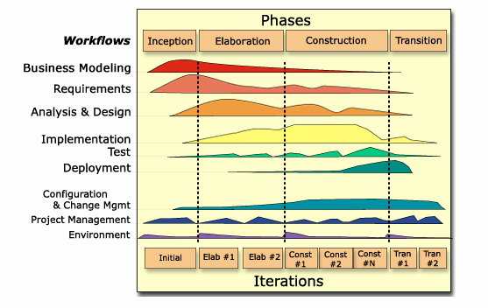
RUP Phases and Disciplines
Notes:
Within each iteration, the tasks are categorized into nine disciplines:
Six "engineering disciplines"
Business Modeling
Requirements
Analysis and Design
Implementation
Test
Deployment
Three supporting disciplines
Configuration and Change Management
Project Management
Environment

Slide 24
Static workflows in the Rational Unified Process
Workflow | Description
Business modelling | The business processes are modelled using business use cases.
Requirements | Actors who interact with the system are identified and use cases are developed to model the system requirements.
Analysis and design | A design model is created and documented using architectural models, component models, object models and sequence models.
Implementation | The components in the system are implemented and structured into implementation sub-systems. Automatic code generation from design models helps accelerate this process.
6 core engineering workflow and 3 core supporting workflow

Slide 25
Static workflows in the Rational Unified Process
Workflow | Description
Testing | Testing is an iterative process that is carried out in conjunction with implementation. System testing follows the completion of the implementation.
Deployment | A product release is created, distributed to users and installed in their workplace.
Configuration and change management | This supporting workflow managed changes to the system (see Chapter 25).
Project management | This supporting workflow manages the system development (see Chapters 22 and 23).
Environment | This workflow is concerned with making appropriate software tools available to the software development team.

Slide 26
RUP good practice (six fundamental practices)
Develop software iteratively
Plan increments based on customer priorities and deliver highest priority increments first.
Manage requirements
Explicitly document customer requirements and keep track of changes to these requirements.
Use component-based architectures
Organize the system architecture as a set of reusable components.
Visually model software
Use graphical UML models to present static and dynamic views of the software.
Verify software quality
Ensure that the software meet’s organizational quality standards.
Control changes to software
Manage software changes using a change management system and configuration management tools.

Slide 27
Process improvement
How to deliver a cheaper and better software quickly?
Improve software process is a way to enhance quality, reduce cost, or accelerate development of software
Many software companies have turned to software process improvement (SPI) as a way of enhancing the quality of their software, reducing costs or accelerating their development processes.
Software Engineering Institute's CMMI (Capability Maturity Model Integration)
ISO/IEC 12207 Software Life Cycle Process
Process improvement means understanding existing processes and changing these processes to increase product quality and/or reduce costs and development time.
Process improvement is a long-term and continuous activity

Slide 28
Agile methods

Slide 29
Agile methods
Dissatisfaction with the overheads involved in software design methods of the 1980s and 1990s led to the creation of agile methods. These methods:
Focus on the code rather than the design
Are based on an iterative approach to software development
Are intended to deliver working software quickly and evolve this quickly to meet changing requirements.
The aim of agile methods is to reduce overheads in the software process (e.g. by limiting documentation) and to be able to respond quickly to changing requirements without excessive rework.

Slide 30
Agile manifesto
We are uncovering better ways of developing software by doing it and helping others do it. Through this work we have come to value:
Individuals and interactions over processes and tools Working software over comprehensive documentation Customer collaboration over contract negotiation Responding to change over following a plan
That is, while there is value in the items on the right, we value the items on the left more.

Slide 31
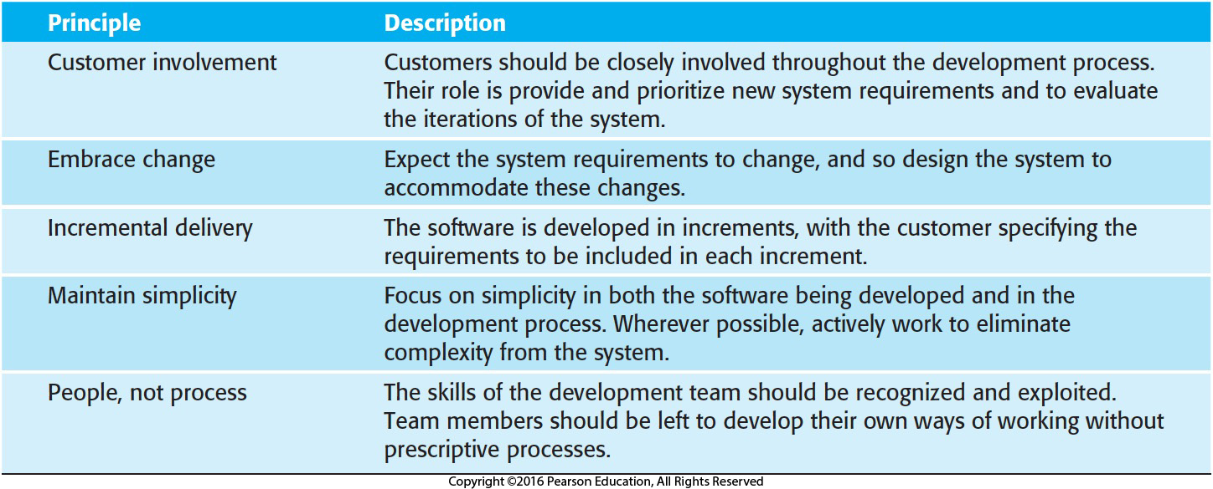
The principles of agile methods

Slide 32
Agile method applicability
Product development where a software company is developing a small or medium-sized product for sale.
Virtually all software products and apps are now developed using an agile approach
Custom system development within an organization, where there is a clear commitment from the customer to become involved in the development process and where there are few external rules and regulations that affect the software.

Slide 33
Extreme programming
A very influential agile method, developed in the late 1990s, that introduced a range of agile development techniques.
Extreme Programming (XP) takes an ‘extreme’ approach to iterative development.
New versions may be built several times per day;
Increments are delivered to customers every 2 weeks;
All tests must be run for every build and the build is only accepted if tests run successfully.

Slide 34
Extreme programming practices (a)
Principle or practice | Description
Incremental planning | Requirements are recorded on story cards and the stories to be included in a release are determined by the time available and their relative priority. The developers break these stories into development ‘Tasks’. See Figures 3.5 and 3.6.
Small releases | The minimal useful set of functionality that provides business value is developed first. Releases of the system are frequent and incrementally add functionality to the first release.
Simple design | Enough design is carried out to meet the current requirements and no more.
Test-first development | An automated unit test framework is used to write tests for a new piece of functionality before that functionality itself is implemented.
Refactoring | All developers are expected to refactor the code continuously as soon as possible code improvements are found. This keeps the code simple and maintainable.

Slide 35
Extreme programming practices (b)
Pair programming | Developers work in pairs, checking each other’s work and providing the support to always do a good job.
Collective ownership | The pairs of developers work on all areas of the system, so that no islands of expertise develop and all the developers take responsibility for all of the code. Anyone can change anything.
Continuous integration | As soon as the work on a task is complete, it is integrated into the whole system. After any such integration, all the unit tests in the system must pass.
Sustainable pace | Large amounts of overtime are not considered acceptable as the net effect is often to reduce code quality and medium term productivity
On-site customer | A representative of the end-user of the system (the customer) should be available full time for the use of the XP team. In an extreme programming process, the customer is a member of the development team and is responsible for bringing system requirements to the team for implementation.

Slide 36
XP and agile principles
Incremental development is supported through small, frequent system releases.
Customer involvement means full-time customer engagement with the team.
People not process through pair programming, collective ownership and a process that avoids long working hours.
Change supported through regular system releases.
Maintaining simplicity through constant refactoring of code.

Slide 37
Influential XP practices
Extreme programming has a technical focus and is not easy to integrate with management practice in most organizations.
Consequently, while agile development uses practices from XP, the method as originally defined is not widely used.
Key practices
User stories for specification
Refactoring
Test-first development
Continuous integration
Pair programming

Slide 38
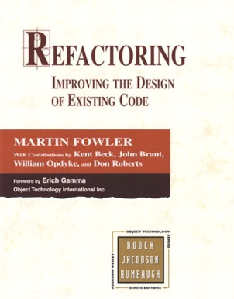
Refactoring
Conventional wisdom in software engineering is to design for change. It is worth spending time and effort anticipating changes as this reduces costs later in the life cycle.
XP, however, maintains that this is not worthwhile as changes cannot be reliably anticipated.
Rather, it proposes constant code improvement (refactoring) to make changes easier when they have to be implemented.
Refactoring is a disciplined technique for restructuring an existing body of code, altering its internal structure without changing its external behavior

Slide 39
Refactoring
Programming team look for possible software improvements (i.e., code smells) and make these improvements even where there is no immediate need for them.
This improves the understandability of the software and so reduces the need for documentation.
Changes are easier to make because the code is well-structured and clear.
However, some changes requires architecture refactoring and this is much more expensive.

Slide 40
Examples of refactoring
Re-organization of a class hierarchy to remove duplicate code.
Tidying up and renaming attributes and methods to make them easier to understand.
The replacement of inline code with calls to methods that have been included in a program library.
Extract and move, …
Eclipse IDE has supported several types of refactoring to improve the structures of Java elements (class or method)

Slide 41
Test-first development (TF, TFD)
Testing is central to XP and XP has developed an approach where the program is tested after every change has been made.
Write a failing test first and make it green by writing exactly enough production code to do so
XP testing features:
Test-first development.
Incremental test development from scenarios.
User involvement in test development and validation.
Automated test harnesses are used to run all component tests each time that a new release is built.

Slide 42
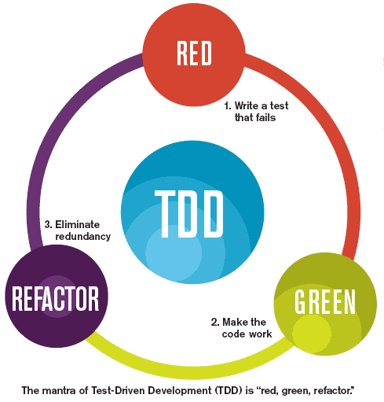
Test-driven development (TDD)
Writing tests before code clarifies the requirements to be implemented.
Tests are written as programs rather than data so that they can be executed automatically. The test includes a check that it has executed correctly.
Usually relies on a testing framework such as Junit.
All previous and new tests are run automatically when new functionality is added, thus checking that the new functionality has not introduced errors.
TDD
is a software development process that relies on the repetition of a very short development cycle. Requirements are turned into very specific test cases, then the software is improved to pass the new tests.
The test-code-refactor cycle

Slide 43
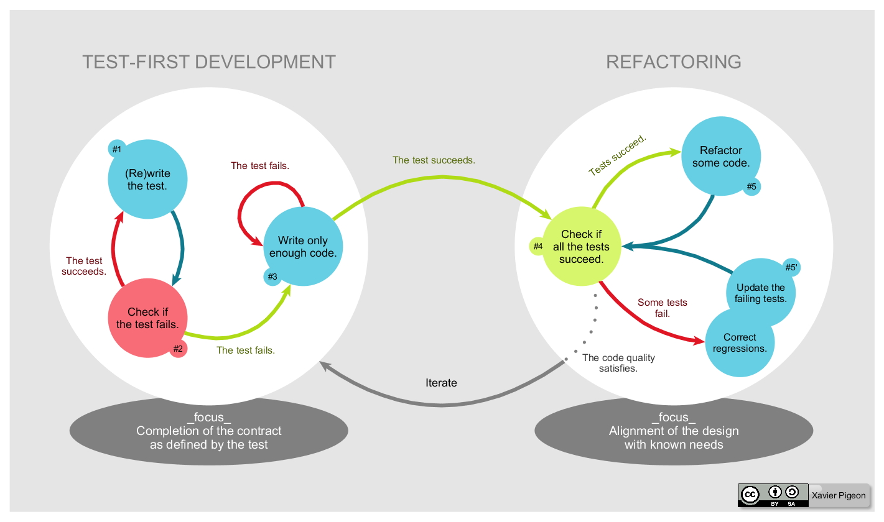
Test-driven development (TDD) (from wiki)

Slide 44
Customer involvement
The role of the customer in the testing process is to help develop acceptance tests for the stories that are to be implemented in the next release of the system.
The customer who is part of the team writes tests as development proceeds. All new code is therefore validated to ensure that it is what the customer needs.
However, people adopting the customer role have limited time available and so cannot work full-time with the development team. They may feel that providing the requirements was enough of a contribution and so may be reluctant to get involved in the testing process.

Slide 45
Problems with test-first development
Programmers prefer programming to testing and sometimes they take short cuts when writing tests. For example, they may write incomplete tests that do not check for all possible exceptions that may occur.
Some tests can be very difficult to write incrementally. For example, in a complex user interface, it is often difficult to write unit tests for the code that implements the ‘display logic’ and workflow between screens.
It difficult to judge the completeness of a set of tests. Although you may have a lot of system tests, your test set may not provide complete coverage.

Slide 46
Pair programming
Pair programming involves programmers working in pairs, developing code together.
This helps develop common ownership of code and spreads knowledge across the team.
It serves as an informal review process as each line of code is looked at by more than 1 person.
It encourages refactoring as the whole team can benefit from improving the system code.

Slide 47
Pair programming
In pair programming, programmers sit together at the same computer to develop the software.
Pairs are created dynamically so that all team members work with each other during the development process.
The sharing of knowledge that happens during pair programming is very important as it reduces the overall risks to a project when team members leave.
Pair programming is not necessarily inefficient and there is some evidence that suggests that a pair working together is more efficient than 2 programmers working separately.

Slide 48
Agile project management

Slide 49
Agile project management
The principal responsibility of software project managers is to manage the project so that the software is delivered on time and within the planned budget for the project.
The standard approach to project management is plan-driven. Managers draw up a plan for the project showing what should be delivered, when it should be delivered and who will work on the development of the project deliverables.
Agile project management requires a different approach, which is adapted to incremental development and the practices used in agile methods.

Slide 50
Scrum
Scrum is an agile method that focuses on managing iterative development rather than specific agile practices.
There are three phases in Scrum.
The initial phase is an outline planning phase where you establish the general objectives for the project and design the software architecture.
This is followed by a series of sprint cycles, where each cycle develops an increment of the system.
The project closure phase wraps up the project, completes required documentation such as system help frames and user manuals and assesses the lessons learned from the project.

Slide 51
Scrum terminology (a)
Scrum term | Definition
Development team | A self-organizing group of software developers, which should be no more than 7 people. They are responsible for developing the software and other essential project documents.
Potentially shippable product increment | The software increment that is delivered from a sprint. The idea is that this should be ‘potentially shippable’ which means that it is in a finished state and no further work, such as testing, is needed to incorporate it into the final product. In practice, this is not always achievable.
Product backlog | This is a list of ‘to do’ items which the Scrum team must tackle. They may be feature definitions for the software, software requirements, user stories or descriptions of supplementary tasks that are needed, such as architecture definition or user documentation.
Product owner | An individual (or possibly a small group) whose job is to identify product features or requirements, prioritize these for development and continuously review the product backlog to ensure that the project continues to meet critical business needs. The Product Owner can be a customer but might also be a product manager in a software company or other stakeholder representative.

Slide 52
Scrum terminology (b)
Scrum term | Definition
Scrum | A daily meeting of the Scrum team that reviews progress and prioritizes work to be done that day. Ideally, this should be a short face-to-face meeting that includes the whole team.
ScrumMaster | The ScrumMaster is responsible for ensuring that the Scrum process is followed and guides the team in the effective use of Scrum. He or she is responsible for interfacing with the rest of the company and for ensuring that the Scrum team is not diverted by outside interference. The Scrum developers are adamant that the ScrumMaster should not be thought of as a project manager. Others, however, may not always find it easy to see the difference.
Sprint | A development iteration. Sprints are usually 2-4 weeks long.
Velocity | An estimate of how much product backlog effort that a team can cover in a single sprint. Understanding a team’s velocity helps them estimate what can be covered in a sprint and provides a basis for measuring improving performance.

Slide 53
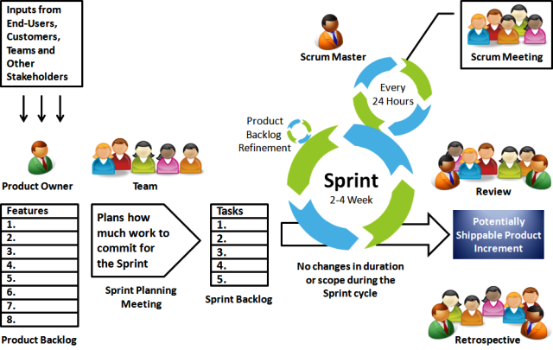
Scrum Process Framework

Slide 54
The Scrum sprint cycle
Sprints are fixed length, normally 2–4 weeks.
The starting point for planning is the product backlog, which is the list of work to be done on the project.
The selection phase involves all of the project team who work with the customer to select the features and functionality from the product backlog to be developed during the sprint.

Slide 55
The Sprint cycle
Once these are agreed, the team organize themselves to develop the software.
During this stage the team is isolated from the customer and the organization, with all communications channelled through the so-called ‘Scrum master’.
The role of the Scrum master is to protect the development team from external distractions.
At the end of the sprint, the work done is reviewed and presented to stakeholders. The next sprint cycle then begins.

Slide 56
Teamwork in Scrum
The ‘Scrum master’ is a facilitator who arranges daily meetings, tracks the backlog of work to be done, records decisions, measures progress against the backlog and communicates with customers and management outside of the team.
The whole team attends short daily meetings (Scrums) where all team members share information, describe their progress since the last meeting, problems that have arisen and what is planned for the following day.
This means that everyone on the team knows what is going on and, if problems arise, can re-plan short-term work to cope with them.

Slide 57
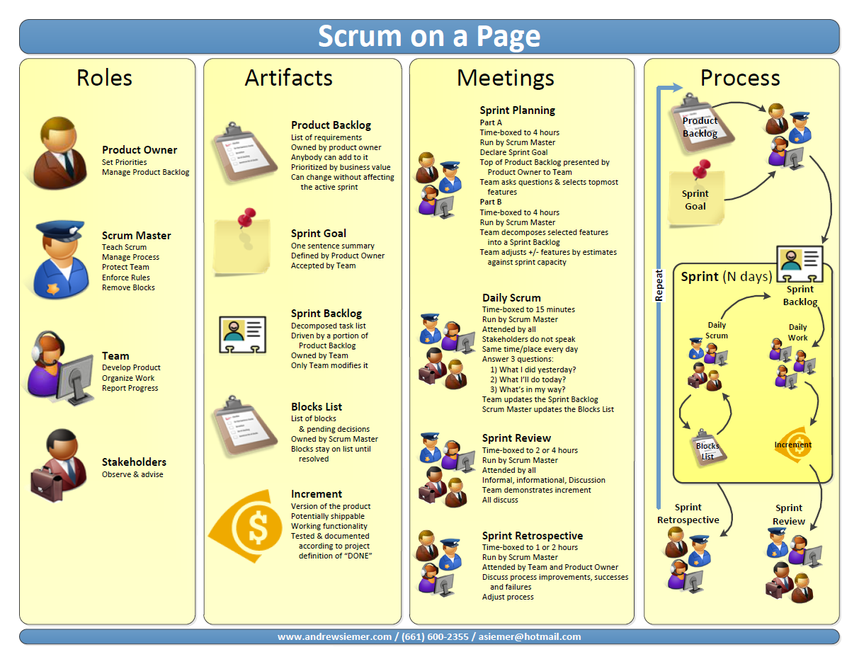

Slide 58
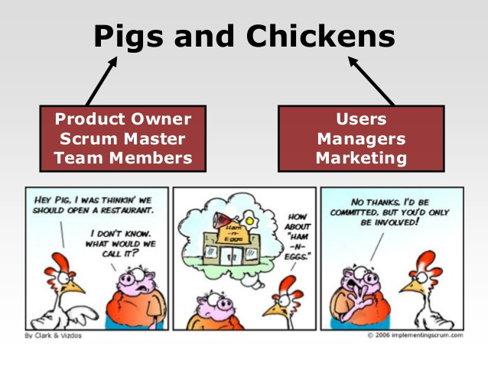
Committed and Involved

Slide 59
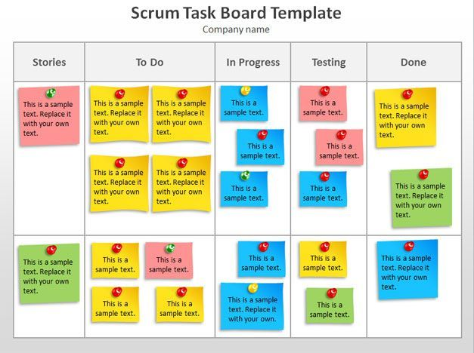
Scrum Task Board

Slide 60
Scrum benefits
The product is broken down into a set of manageable and understandable chunks.
Unstable requirements do not hold up progress.
The whole team have visibility of everything and consequently team communication is improved.
Customers see on-time delivery of increments and gain feedback on how the product works.
Trust between customers and developers is established and a positive culture is created in which everyone expects the project to succeed.

Slide 61
Q & A
Q & A

